Slide 1
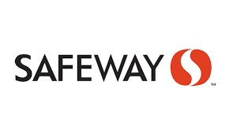
Live Inventory Chatbot
Team SAS
Sankalp Thakur
Anderson Klein
Srivatsav Vuddamarry

Slide 2
Rationale for selecting the company
Being ready for the Pandemic Situations
First Movers Advantage
Improves the Customer Experience
Saves time and Energy

Slide 3
Competitors:
Target
Walmart
Local Mom & Pop Shops
Whole Foods

Slide 4
Strategic Advantage over the Customers:
Yes. No other competitor has been implementing it so far.
Will Increase the footfall of the customers.
Will help Safeway increase its Dynamic Capabilities

Slide 5
Project Plan
The Project Plan would have four phases:
Planning
Analysis
Prototype
Review

